Slide 1

ELL Leadership Academy
Karina E. Chapa, M.Ed.
Language Proficiency, Biliteracy
and Cultural Diversity Director
kchapa@esc1.net

Slide 2

Professional Learning Essential Agreements
Be respectful of others
Be an active participant
Take care of your needs
Use electronic devices as learning tools

Slide 3

Edmodo Code: ktms9k
www.edmodo.com

Slide 4

Day 1 Review
Scan the QR Code or go to: http://tinyurl.com/RGCCISD
Type something you remember from Day 1 of the Academy

Slide 5
Second language acquisition
Continuation

Slide 6
Factors that Impact Second Language Acquisition
Motivation and attitude
First language development
Age
Cultural background
Quality of instruction
Personality
Peers and role models
Access to the language
Language distance
Take a Stand

Slide 7
Five SLA Hypothesis
Acquisition vs Learning Hypothesis
Monitor Hypothesis
Natural Order Hypothesis
Input Hypothesis
Affective Filter Hypothesis

Slide 8
Expert Jigsaw: Tree Map
Krashen’s Five Hypothesis
Learning vs Acquisition
Monitor
Natural Order
Input
Affective Filter

Slide 9
Telpas-elps connection
ELPS LIAG and ELPS Tool

Slide 10
Session Objectives
Content Objective
Today I will examine how to implement the ELPS in all content areas and how to analyze TELPAS data to guide instruction. I will also review the LPAC process to make decisions impacting ELL instruction.
Language Objective
Today I will share (orally and in writing) different ideas on how to linguistically accommodate instruction for ELLs and the role of the LPAC in this process.

Slide 11

ELPS
Anticipation Guide
kahoot.it
create.kahoot.it

Slide 12
Statutory Requirement
19 Texas Administrative Code 74.4 Chapter 74. Curriculum Requirements Subchapter A. Required Curriculum 74.4 English Language Proficiency Standards
Adopted December 2007

Slide 13


ELPS Resources
LIAG and ELPS Instructional Tool

Slide 14
ELPS: How are they organized?
Big Ideas
1. Make Content Comprehensible
2. Develop Academic Language
Big Responsibilities
1. Communicated
2. Sequenced
3. Scaffolded
Student Expectations
1. Listening
2. Speaking
3. Reading
4. Writing
5. Learning Strategies
PLDs (L, S, R, W)
1. Beginning
2. Intermediate
3. Advanced
4. Advanced High

Slide 15
ELPS Mingle!
  Listening PLDs
  Listening Expectations & CCRS
  Listening Teacher Behaviors
  Speaking PLDs
  Speaking Expectations & CCRS
  Speaking Teacher Behaviors
  Reading 2-12 PLDs
  Reading Expectations & CCRS
  Reading Teacher Behaviors
  Writing 2-12 PLDs
  Writing Expectations & CCRS
  Writing Teacher Behaviors

Slide 16
TELPAS-ELPS Connection
Utilizing TELPAS to Guide Instruction

Slide 17
TEKS vs ELPS
STAAR
TELPAS
T
E
K
S
E
L
P
S

Slide 18
TEKS vs ELPS
Academic Proficiency Language Proficiency
STAAR
TELPAS
TEKS
ELPS
Relating Factor: evaluates/measures

Slide 19
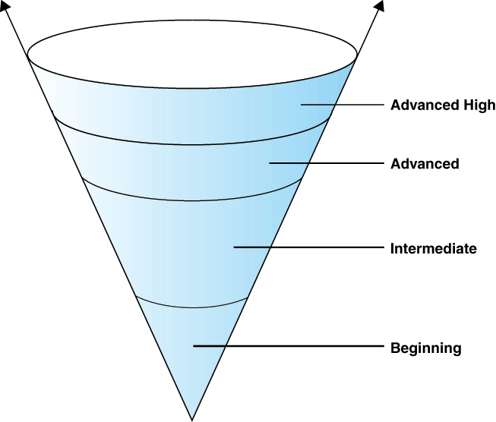
TELPAS Levels

Slide 20
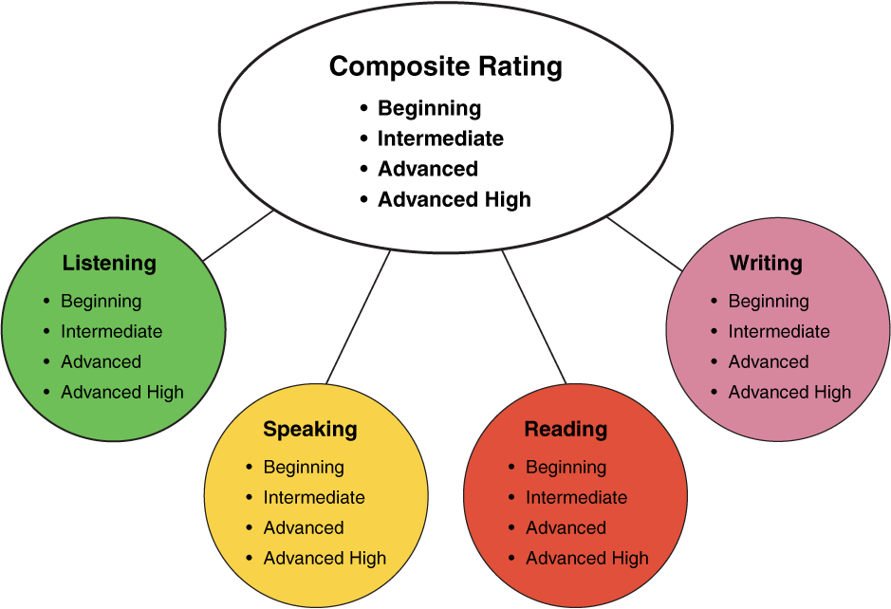
TELPAS Domains
10%
30%
10%
50%

Slide 21
ELPS Resources
LIAG and ELPS Instructional Tool
+
DMAC Reports

Slide 22
DMAC TELPAS Reports
How to Run TELPAS Reports by Language Domain
Go to Home Page
Go to State Assessment
Select TELPAS
Select Instructional Reports
Teacher Tab
Select Year and Campus
Select Student Language Proficiency Rating
Generate Report

Slide 23
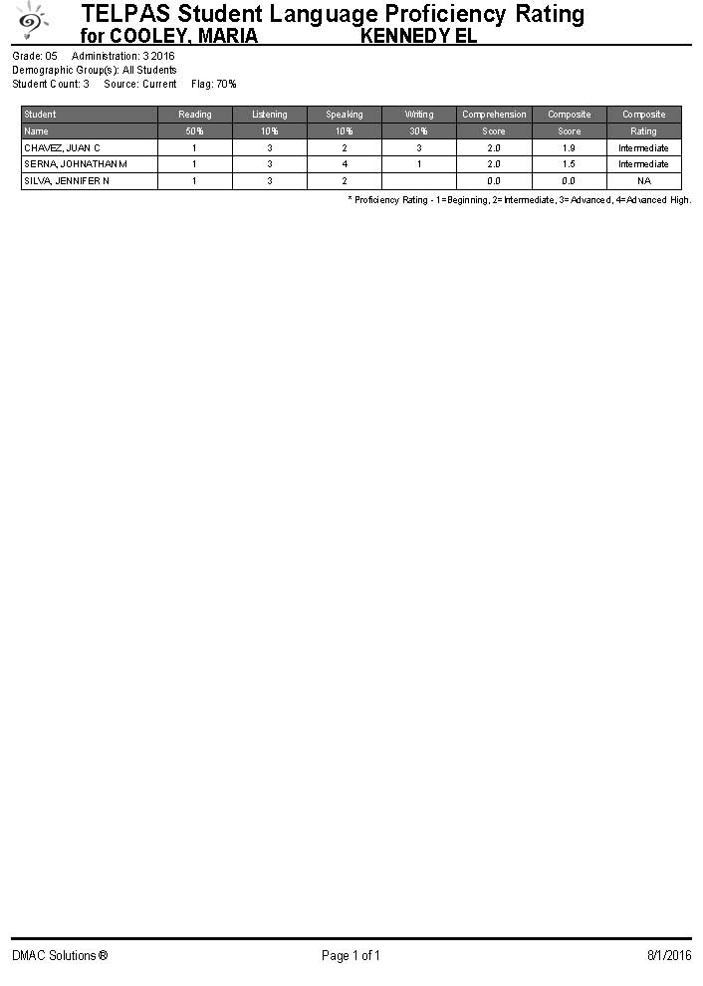
Sample DMAC Report

Slide 24
ELPS for Administrators
Go to: www.texascourses.org
Sign Up: Create an account
Search: ELPS
Find: ELPS for Administrators
Complete course

Slide 25
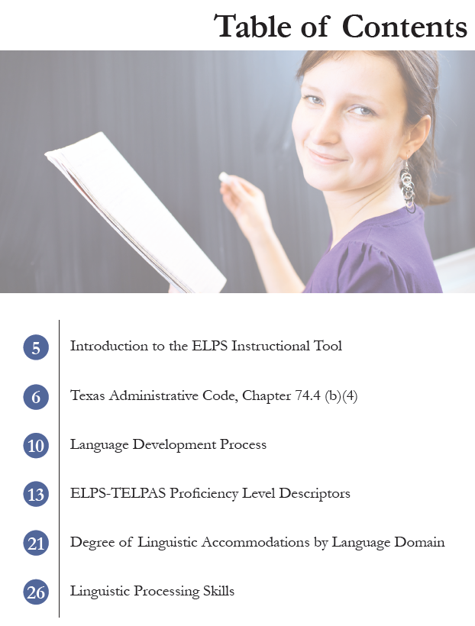
ELPS Instructional Tool
Meeting the needs of beginning and intermediate ELLs

Slide 26
TAC, Chapter 74.4 (b) (4)
… provide intensive ongoing foundational second language acquisition instruction to ELLs in Grade 3 or higher who are at the beginning or intermediate level of English Language proficiency in listening, speaking, reading and/or writing as determined by the state’s English language proficiency assessment system.

Slide 27
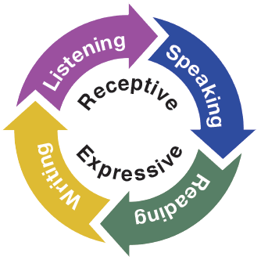
Second Language Acquisition
ELPS Instructional Tool
Instruction must be focused, targeted, and systematic

Slide 28
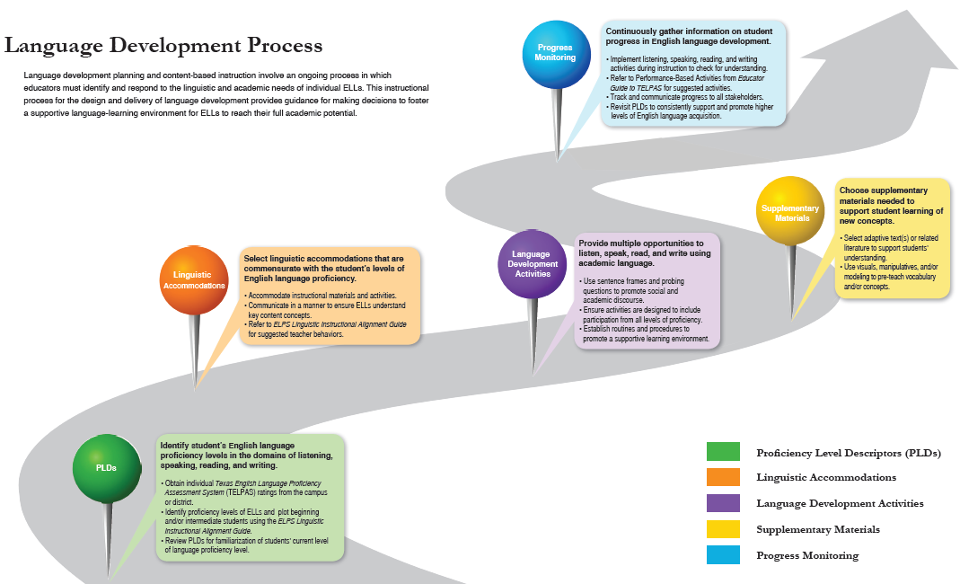
EMOJIS

Slide 29
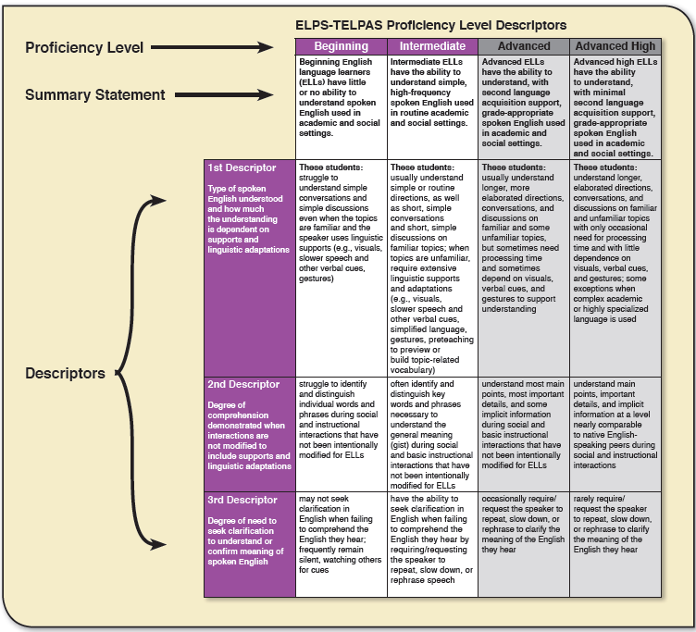
T-Chart

Slide 30
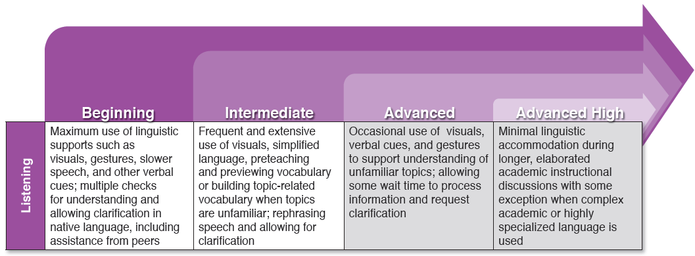
Degree of Linguistic Accommodations by Domain

Slide 31
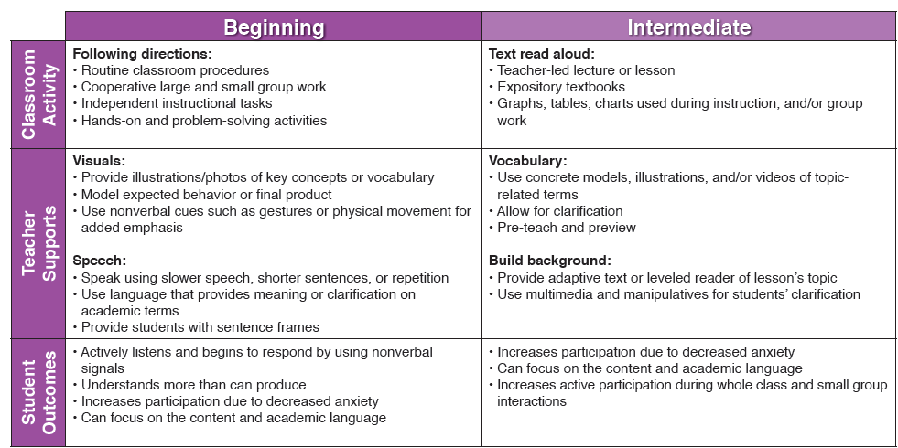
Degree of Linguistic Accommodations by Domain

Slide 32
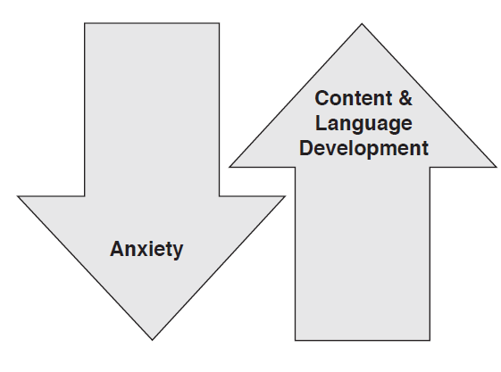
Linguistic Processing Skills
Create a Lesson! Tool, pages 28-33
Sentence frames provide students with the means to receive and express language while reducing their anxiety.
Levels of content and language development will increase as students do not have to contend with context, grammar, and syntax simultaneously.

Slide 33
LPAC Procedures
Instructional Impact

Slide 34

Providing Comprehensible Input
http://programs.esc20.net/default.aspx?name=lpac.resources

Slide 35
LPAC Procedures
Initial Identification Process

Slide 36
LPAC Procedures
Initial Identification Process

Slide 37
ELL Exit Criteria

Slide 39
Session Objectives
Content Objective
Today I will examine how to implement the ELPS in all content areas and how to analyze TELPAS data to guide instruction. I will also review the LPAC process to make decisions impacting ELL instruction.
Language Objective
Today I will share (orally and in writing) different ideas on how to linguistically accommodate instruction for ELLs and the role of the LPAC in this process.

Slide 40

Leadership: Know Thyself
www.16personalities.com

Slide 41
Tickets Out
I used to think…
But now I know…

Slide 42
Thank you for your participation!
Karina E. Chapa, M.Ed.
Language Proficiency, Biliteracy and Cultural Diversity Director
kchapa@esc1.net
Facebook: Region One ESC Bilingual
Twitter @esc1bilingual @bilingualpride

